Slide 1
Photo Manager
A project by Aaron Bolyard , Grace Ross, and Nicholas Zwan.

Slide 2
Why Photo Manager?
User can create a unique Username and password for their account.
The user will have unfettered access to content they upload.
Ability to view, store, and delete photos.
On the backend photo manager accesses a database for storage, retrieval, and modification.
Photo manager will use Google API to “tag” photos. Available options will include people, places, landmarks, objects, and ETC.

Slide 3
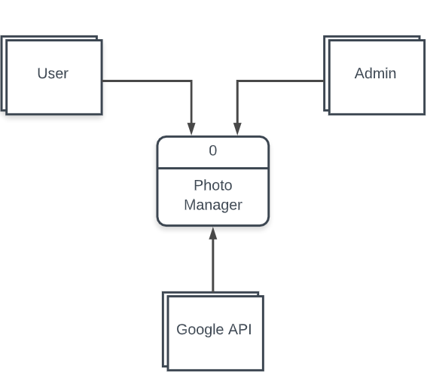
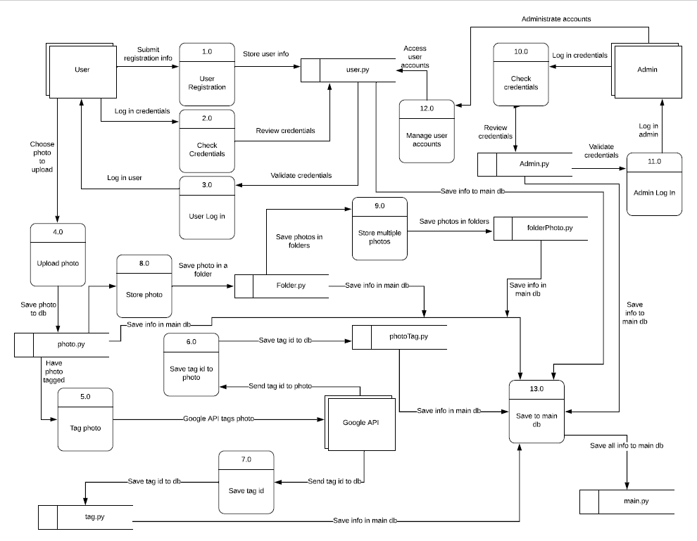
How it works!

Slide 4


What’s inside?
Photo Manager is written in Python using Flask and SQL Alchemy.

Slide 5
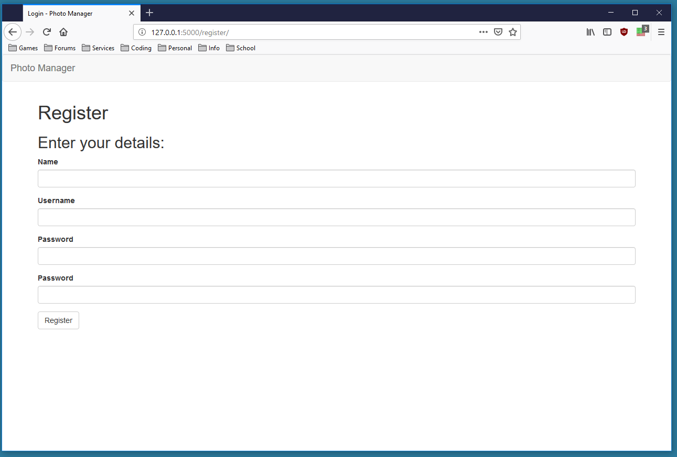
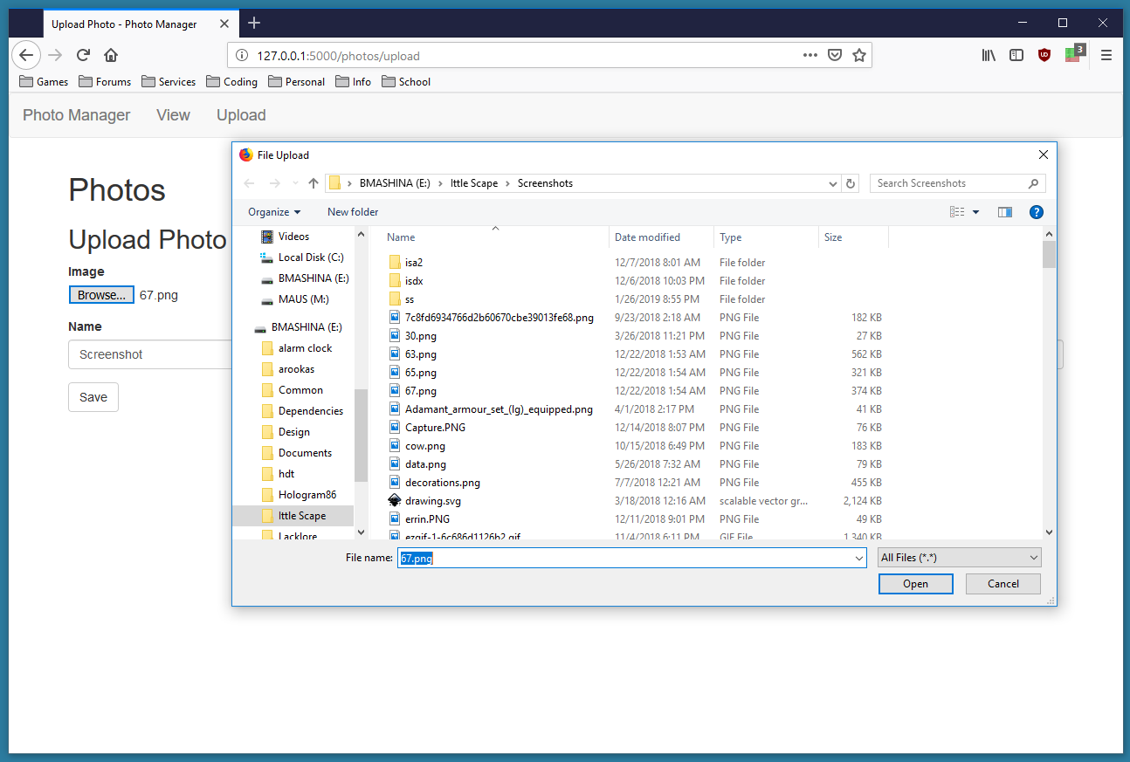
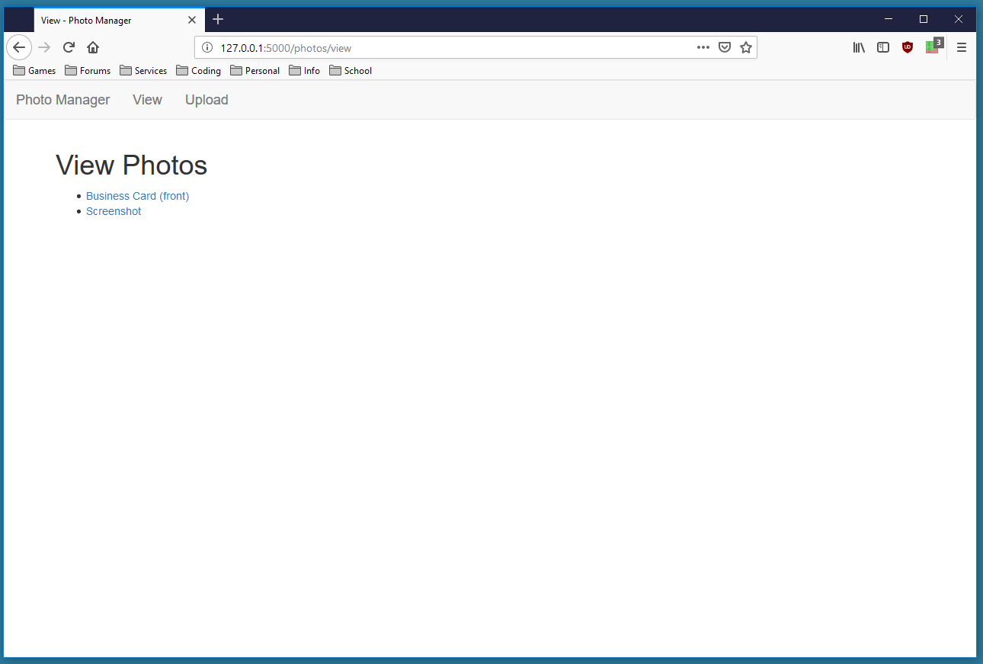
Where were at.
At present Photo manager supports the following functions:
Create account (Username and Password), Login and Logout
Upload Photo, View Photo, and Delete Photo.

Slide 6

Where we are headed.
Photo Manager will allow user access to their uploaded photos and use google API for tagging purposes.
User will be able to store, retrieve, and view tagged photos.
User will have their own profile for social purposes.

